Slide 1
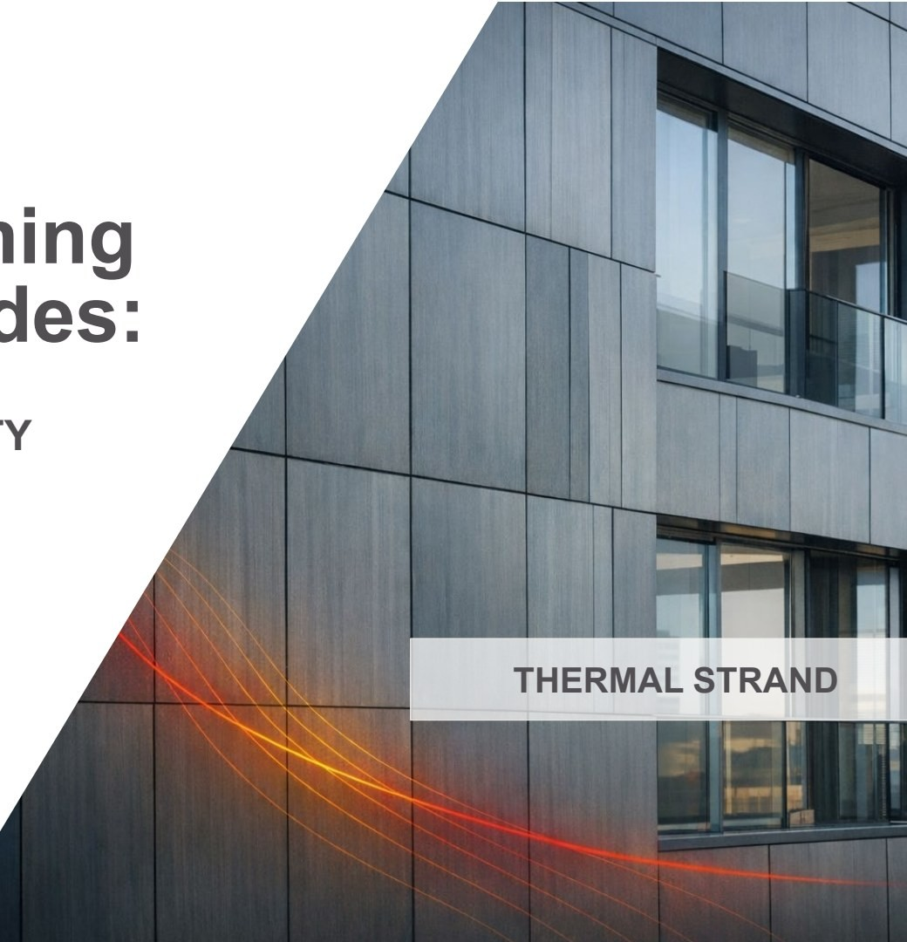
HILTI
Mastering subframing
in rainscreen façades:
BALANCING PERFORMANCE,
SUSTAINABILITY, AND DURABILITY
Jesus Barreda, P.E.
April 2026
THERMAL STRAND

Slide 2

Agenda
1.0
Introduction & Objectives
2.0
The Real Impact of Thermal Bridging
3.0
Calculation Workflow
4.0
Design Levers & Best Practices
5.0
From Intent to Reality
6.0
Key Takeaways & Next Steps
HILTI
Mastering Subframing in Rainscreen Façades - Balancing Performance, Sustainability, and Durability
/ 2

Slide 3
Learning objectives
Upon completion of this presentation, the participant should be able to:
Identify
Diagnose
Differentiate
Evaluate
the mechanisms by which subframing creates thermal bridges and how repetition, geometry, and material choices amplify their impact on real assembly performance.
The conditions under which thermal bridges, localized cold zones, and dew-point risk emerge in ventilated façade assemblies.
between nominal R-value, effective R-value, U-value, and point thermal transmittance, and explain how subframing affects each.
subframing approaches, including conventional, thermally broken, and low-conductivity support strategies, based on real thermal consequences rather than product claims alone.
Integrate
architectural details, specification requirements, and performance verification practices that preserve intended thermal performance in the built assembly.
HILTI
Mastering Subframing in Rainscreen Façades - Balancing Performance, Sustainability, and Durability
/ 3

Slide 4
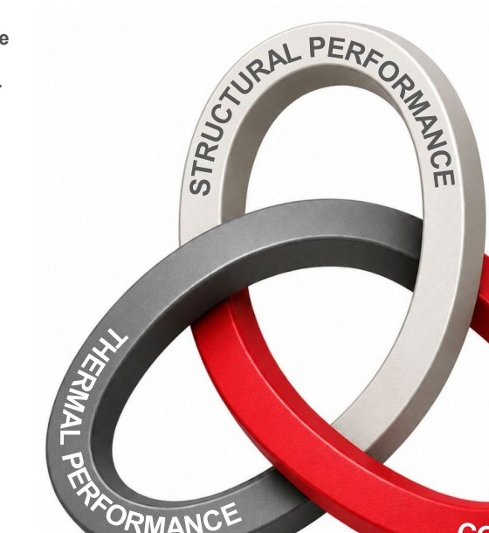
The Performance Knot: An Integrated Design Model
The Performance Knot turns structure, thermal performance, and constructability into one visual model, so teams can see how decisions interact, where risk appears, and where better solutions are created.
PERFORMANCE
Delivered effective R-value, comfort, code compliance, structural reliability, and predictable installation
SUSTAINABILITY
Lower operational energy, lower carbon impact over time, fewer substitutions, and more efficient use of materials
DURABILITY
Reduced condensation risk, fewer moisture issues, better material compatibility, reliable load path and long-term façade performance.
No one requirement should be optimized at the expense of another.
The result is a façade that performs better, lasts longer, and creates more value over time.
HILTI
Mastering Subframing in Rainscreen Façades - Balancing Performance, Sustainability, and Durability
/ 4

Slide 5
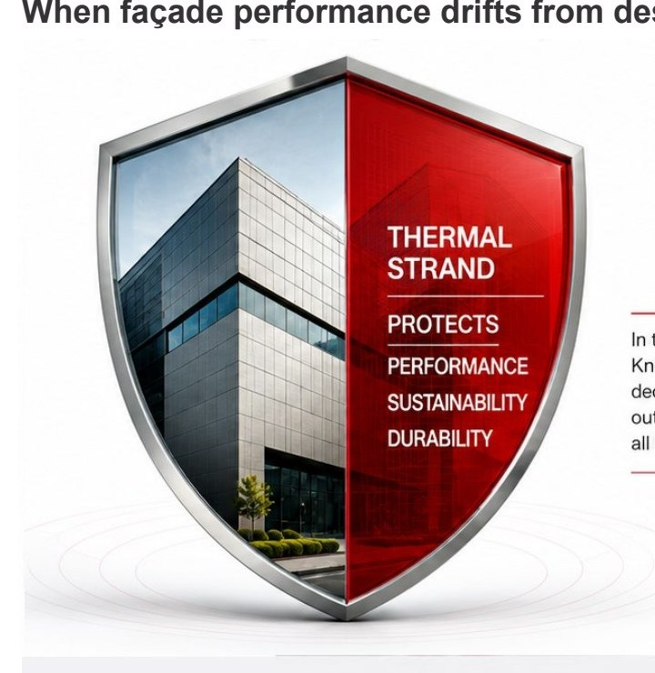
Thermal performance protects owner value
When façade performance drifts from design intent, it becomes an incremental recurring expense.
Lower Operating Cost
Lower electricity consumption.
Reduced heating and cooling demand over the life of the building.
Better Occupant Experience
Fewer cold spots. Fewer moisture complaints.
Better thermal continuity helps reduce cold interior surfaces, staining, condensation, mold concerns, and occupant discomfort.
Lower Long-Term Risk
Stronger outcomes.
Reduced exposure to moisture issues, warranty claims, investigations, and corrective work.
Thermal is where design intent becomes owner outcomes.
HILTI
Mastering Subframing in Rainscreen Façades - Balancing Performance, Sustainability, and Durability
/ 5

Slide 6
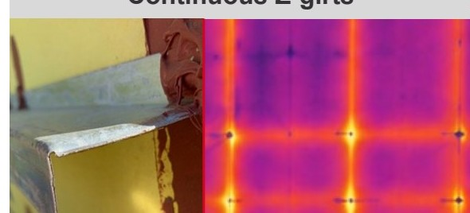
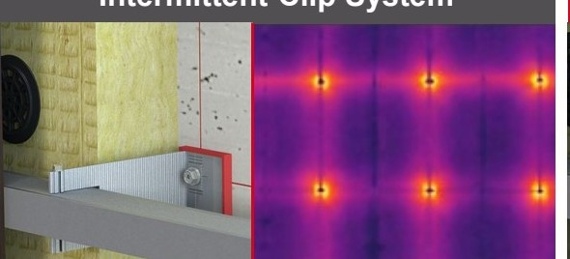
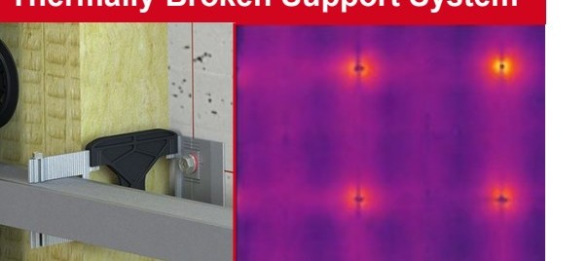
The hidden cost of standard subframing
Real walls can lose far more thermal value than the insulation label suggests.
Continuous Z-girts
Intermittent Clip System
Thermally Broken Support System
R-VALUE REDUCTION
R-VALUE REDUCTION
R-VALUE REDUCTION
~50%
~20-25%
~5%
Continuous metal supports create significant thermal bridges.
An intermittent thermally broken subframing system performs better, but there's room to improve.
An intermittent thermal-bridge-free subframing system helps minimize heat flow and maximize thermal performance.
SAME WALL INTENT, DIFFERENT THERMAL OUTCOME.
SAME INSULATION
DIFFERENT SUPPORT LOGIC
DIFFERENT EFFECTIVE RESULT
Insulation performance remains unchanged.
Support design drives thermal performance.
Lower heat loss. Higher efficiency. Real savings.
HILTI
Mastering Subframing in Rainscreen Façades - Balancing Performance, Sustainability, and Durability
/ 6

Slide 7
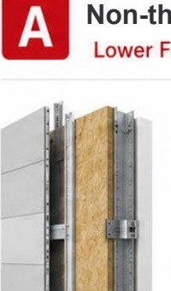
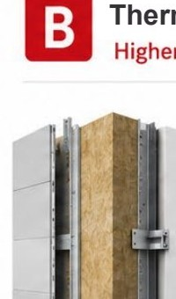
It's not just first cost. It's performance that lasts.
A lower-cost support system can increase operating energy, carbon impact, and long-term risk when effective wall performance is reduced.
A
Non-thermally broken
B
Thermally broken
Lifecycle Cost Over 20 Years
Lower First Cost
Higher Performance
$400k
$380,000
Upfront cost
Upfront cost
$80,000
$100,000
$300k
Lower effective wall R_{eff} = 16
Higher effective wall R_{eff} = 20
$200k
Break-even:
~16 months
Higher annual energy penalty +$15,000/year
Lower operating cost
$100k
$280k
actual savings
with Option B
Lower long-term value
Better long-term value
$0
$80,000
0
5
10
15
20
Years
$20k saved today can become $280k lost over 20 years.
The true cost of subframing is not only the price per sq.ft. It is the wall performance, energy, and durability the owner keeps or loses for decades.
HILTI
Mastering Subframing in Rainscreen Façades - Balancing Performance, Sustainability, and Durability
/ 7

Slide 8
Agenda
1.0
Introduction & Objectives
2.0
The Real Impact of Thermal Bridging
3.0
Calculation Workflow
4.0
Design Levers & Best Practices
5.0
From Intent to Reality
6.0
Key Takeaways & Next Steps
HILTI
Mastering Subframing in Rainscreen Façades - Balancing Performance, Sustainability, and Durability
/ 8

Slide 9
Poll Question 1:
On your rainscreen projects, how is thermal performance most commonly specified or discussed?
A
Mostly by nominal insulation R-value
B
By clear-field wall R-value or U-value
C
By effective whole-wall R-value or U-value, including thermal bridges
D
It varies significantly by project, owner, consultant, or jurisdiction
HILTI
Mastering Subframing in Rainscreen Façades - Balancing Performance, Sustainability, and Durability
/ 9

Slide 10
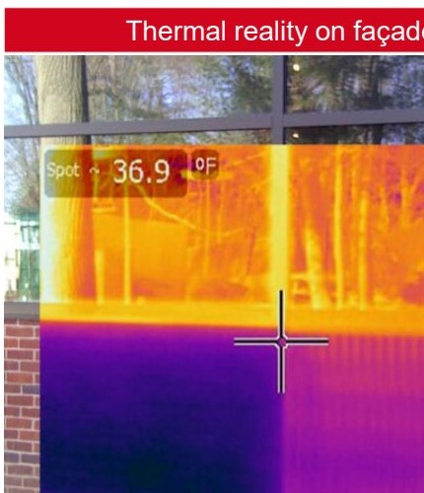
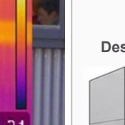

Performance drift begins where the specification gets silent
Third-party façade research found thermal performance losses typically in the 45%-55% range.
Thermal reality on façades
Typical observed thermal
performance loss
If the subframing basis is not defined, three key outcomes can drift.
45%-55%
Thermal drift
Ueff and Reff no longer match design intent.
Sustainability drift
→
Energy and carbon assumptions become less reliable.
Durability drift
Design intent
Installed reality
Cold spots and moisture risk may increase at repeated details.
Performance drop
Thermal bridging at subframing and attachments increases heat loss.
Insulation alone does not define façade performance.
The full subframing assembly has a major impact on real thermal results.
HILTI
Mastering Subframing in Rainscreen Façades - Balancing Performance, Sustainability, and Durability
/ 10

Slide 11
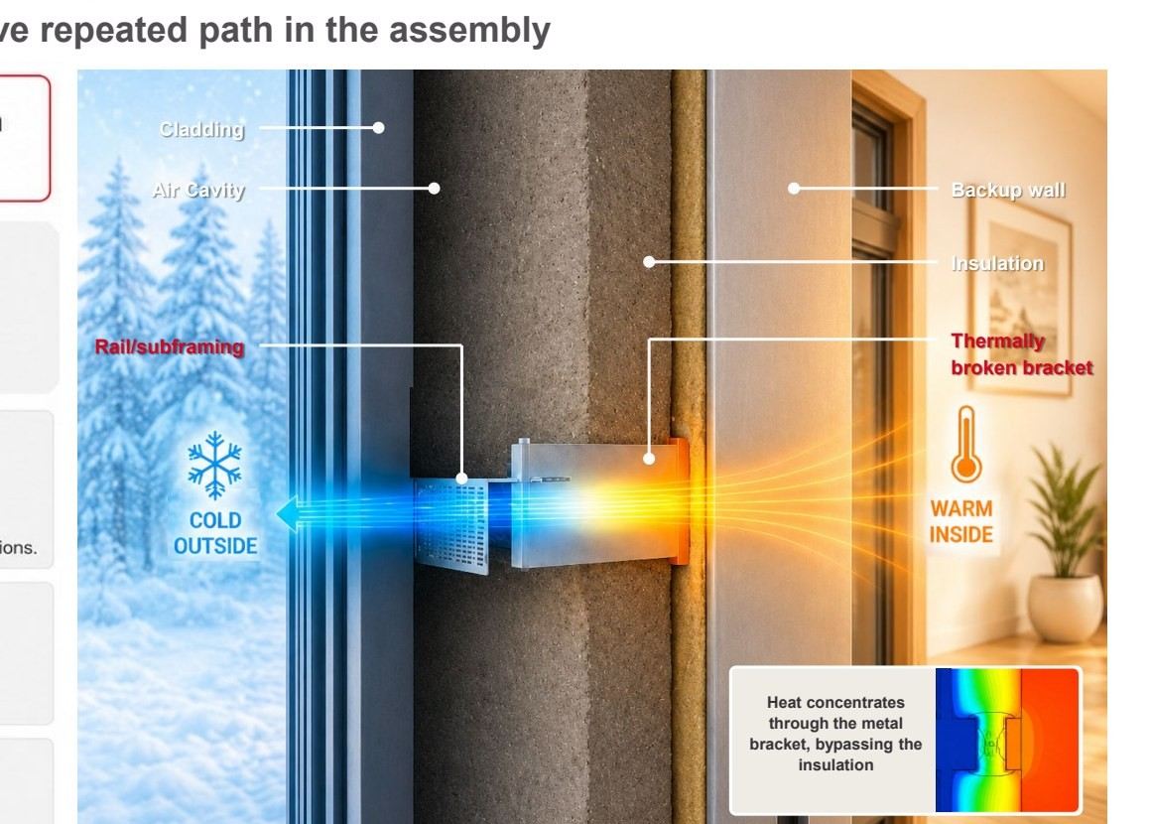
What is Thermal Bridging?
Heat flows through the most conductive repeated path in the assembly
Thermal bridges bypass the insulation
and create a
path of least resistance.
Definition
Thermal bridge = an element or interface with higher conductivity than the surrounding envelope.
Core concept
• Heat flow concentrates through the conductive path.
• Repetition converts a small detail into a whole-wall performance issue.
• Rainscreen supports are common thermal-bridge locations.
Why it matters
• Effective thermal performance drops.
• Localized cold zones can increase condensation risk.
• Repeated details drive whole-wall results.
In rainscreen façades, brackets, rails, and fasteners often create the repeated conductive path.
HILTI
Mastering Subframing in Rainscreen Façades - Balancing Performance, Sustainability, and Durability
/ 11

Slide 12
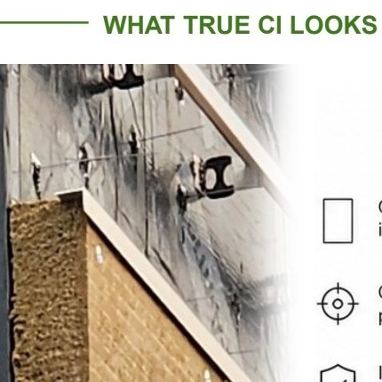
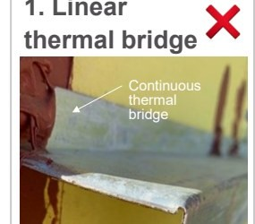
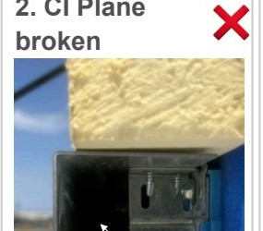
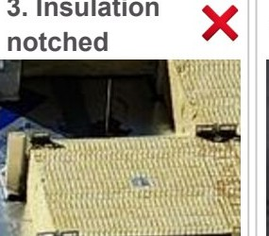
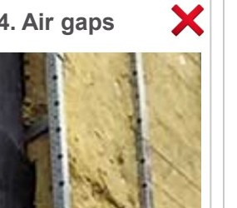
Continuous Insulation (CI) means continuous
CI is only meaningful when continuity is protected and penetrations are accounted for.
COMMON CONDITIONS THAT ARE NOT CI
WHAT TRUE CI LOOKS LIKE
1. Linear thermal bridge
2. CI Plane broken
3. Insulation notched
4. Air gaps
✕
✕
✕
✕
One uninterrupted insulation plane
Only limited discrete penetrations
Insulation remains in place around supports
Support strategy preserves thermal continuity
Creates a direct conductive path
Interrupts the insulation plane
Removes insulation material
Turns continuity into compression and bridging
Continuous Insulation (CI): Insulation material that is continuous across all structural members without thermal bridges other than fasteners and service openings (IECC & ASHRAE 90.1)
WHY IT
MATTERS
Improved thermal performance
Reduced condensation risk (mold formation)
More reliable code and performance compliance
If the insulation plane is interrupted, compressed, notched, or displaced, the thermal penalty and moisture risk must be accounted for.
HILTI
Mastering Subframing in Rainscreen Façades - Balancing Performance, Sustainability, and Durability
/ 12

Slide 13
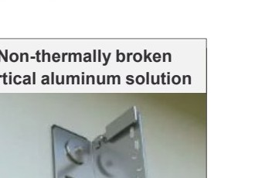
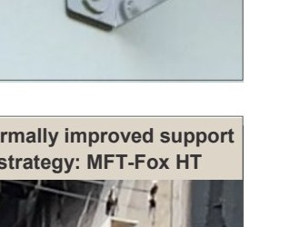
Added insulation doesn’t guarantee higher thermal results
Repeated metal supports create thermal bridges, so support strategy helps determine how much of the intended thermal performance is actually delivered.
THE PHYSICS IS SIMPLE
Relative decrease in R-value due to subframing
Non-thermally broken
vertical aluminum solution
1
Heat bypasses insulation at every repeated support.
70%
60%
Non-thermally broken aluminum vertical solution
Decrease in R-value (%)
50%
Observed in the field
2
Added insulation reduces heat flow through the clear field.
40%
Non-thermally broken aluminum horizontal solution
30%
3
The repeated bridge becomes a larger share of total heat loss.
Thermally improved support
strategy: MFT-Fox HT
20%
10%
Hilti MFT-Fox HT & VT
4
Thermally optimized supports keep the penalty near the 3% threshold.
0%
3.1
3.9
4.7
5.5
6.3
7.1
7.9
8.7
Insulation Thickness (in.)
More insulation improves the clear field, but repeated metal supports can limit the gain. The selected support strategy must preserve thermal performance while meeting load, deflection, movement, and installation requirements.
HILTI
Mastering Subframing in Rainscreen Façades - Balancing Performance, Sustainability, and Durability
/ 13

Slide 14
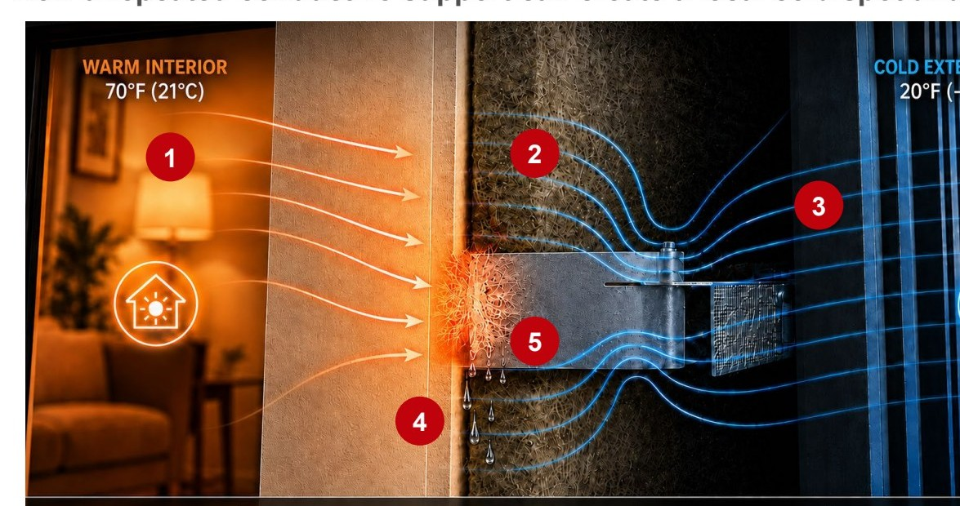
Thermal bridges can become durability risks
How a repeated conductive support can create a local cold spot and condensation risk.
1
CONDUCTION:
Heat flows through the metal support from warm to cold, creating a local thermal bridge.
2
VAPOR DIFFUSION:
Water vapor moves through materials from higher vapor pressure to lower vapor pressure.
3
AIR LEAKAGE:
Moist air can move through gaps or discontinuities in the enclosure due to pressure differences.
4
SURFACE TEMPERATURE:
A conductive support can lower the nearby interior surface temperature and create a local cold spot.
5
CONDENSATION POTENTIAL:
Condensation occurs when the local surface temperature falls at or below the dew point of the adjacent indoor air.
Whole-wall R-value can look acceptable while a repeated support detail still creates local cold-surface condensation risk. Good design manages heat flow, air control, vapor transport, and local surface temperatures together.
Key
takeaway
HILTI
Mastering Subframing in Rainscreen Façades - Balancing Performance, Sustainability, and Durability
/ 14

Slide 15
Lower U-Value. Lower heat loss. Better wall performance.
U-value makes heat flow “visible” so you can design for performance, energy, and owner value.
1. What U-value tells us
2. Heat leak scale
3. Simplified Example
U-Value is the rate of heat flow through 1 ft² of wall for every 1°F difference between inside and outside.
Same area (1,000 ft²) and ΔT (50°F) for every case.
~10 in insulation
~2 in insulation
U-VALUE R-VALUE HEAT LOSS INSULATION
→
U = 0.025
R ≈ 40
≈ 1,250 BTU/hr
~10 in
→→
U = Q / (A × ΔT)
VS
→
→→
→
U = U-Value (Btu/hr·ft²·°F)
Q = Heat flow (Btu/hr) A = Wall area (ft²)
ΔT = Temperature difference (°F)
U = 0.040
R ≈ 25
≈ 2,000 BTU/hr
—
→
U-Value = SPEED of heat flow
(How easily heat moves through the wall)
U = 0.080
R ≈ 12.5
≈ 4,000 BTU/hr
—
U ≈ 0.025
Heat loss
≈ 1,250 BTU/hr
U ≈ 0.125
Heat loss
≈ 6,250 BTU/hr
Q (Heat Flow) = AMOUNT of heat lost
(How much heat is escaping every hour)
U = 0.125
R ≈ 8
≈ 6,250 BTU/hr
~2 in
At the same area and temperature difference, the 2-inch wall leaks about 5× more heat.
WARM INSIDE → COLD OUTSIDE
Lower U, slower heat loss Higher U, faster heat loss
U-value is a thermal metric that makes heat flow visible. It is a direct indicator of how much performance, energy, and owner value the wall keeps or loses.
HILTI
Mastering Subframing in Rainscreen Façades - Balancing Performance, Sustainability, and Durability
/ 15

Slide 16
Compare U_{eff}, not U₀, for real rainscreen performance
Clear-field (U0) describes the ideal wall. Effective U-value (Ueff) captures the thermal bridges introduced by installed subframing and connections.
01
Clear-Field U0
02
Effective U-Value (U_{eff})
Ideal baseline transmittance
Real installed whole-wall transmittance
INTERIOR 70°F
EXTERIOR 20°F
INTERIOR 70°F
EXTERIOR 20°F
Linear bridge Ψ
Point bridge χ
■ Area-averaged background transmittance
■ Accounts for subframing and connection penalties
■ Excludes subframing penalties from rails, brackets, and fasteners
■ Includes linear and point thermal bridges
■ Starting point for thermal calculations
■ Represents the real installed wall performance designers should compare
Ideal baseline
U₀ [W/m²·K]
Real installed performance
U_{eff} [W/m²·K]
Add thermal-bridge effects → installed heat flow increases
U_{eff} = U₀ + Σ(Ψ · L)/A + Σ(χ · n)/A
U0 = clear-field transmittance Ψ = linear thermal transmittance χ = point thermal transmittance
L = total bridge length n = number of point bridges A = wall area
HILTI
Mastering Subframing in Rainscreen Façades - Balancing Performance, Sustainability, and Durability
/ 16

Slide 17
U-value vs. R-value
U-value tells how easily heat flows through the wall. R-value tells how strongly the wall resists heat flow.
U-Value
R-Value
Heat flow rate through the wall assembly
Thermal resistance of the wall assembly
INTERIOR 70°F
EXTERIOR 20°F
INTERIOR 70°F
EXTERIOR 20°F
Inverse
relationship
U = 1 / R
R = 1 / U
Lower U = less heat escapes
Higher R = stronger resistance to heat flow
■ Measures how easily heat moves through the assembly
■ Measures how strongly the wall resists heat flow
■ Lower U-value = better thermal performance
■ Higher R-value = better thermal performance
■ Typical unit: W/m²·K (or BTU/h·ft²·°F)
■ Typical unit: ft²·°F·h/BTU (or m²·K/W)
Think: speed of heat leak
Think: strength of insulation
U₀ focuses on heat flow. R-value focuses on resistance. Lower U and higher R both mean better thermal performance.
HILTI
Mastering Subframing in Rainscreen Façades - Balancing Performance, Sustainability, and Durability
/ 17

Slide 18
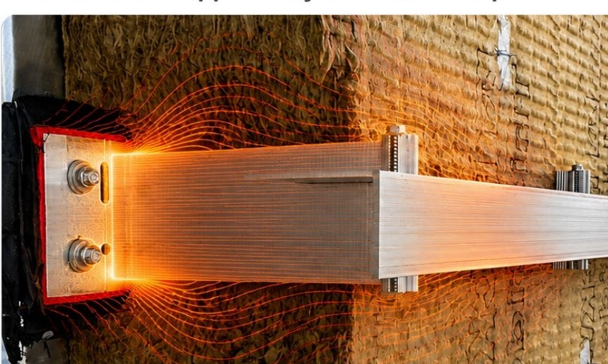
Point Transmittance, χ
One discrete support may look small. Repeated across the façade, it changes the true wall performance.
What it is
Added heat flow caused by one discrete thermal bridge, relative to the clear-field wall baseline.
Units: W/K
Why it matters
Each bracket adds a small penalty. Across the full façade, those penalties accumulate into real whole-wall performance loss.
How it scales
χ × number of supports (n) ÷ gross wall area (A) = assembly correction
Small bracket impacts become building-level consequences.
Higher point transmittance can increase effective U-value, energy demand, and long-term operating cost.
Point transmittance is not just a bracket property. It is a driver of installed wall performance and owner value.
HILTI
Mastering Subframing in Rainscreen Façades - Balancing Performance, Sustainability, and Durability
/ 18

Slide 19
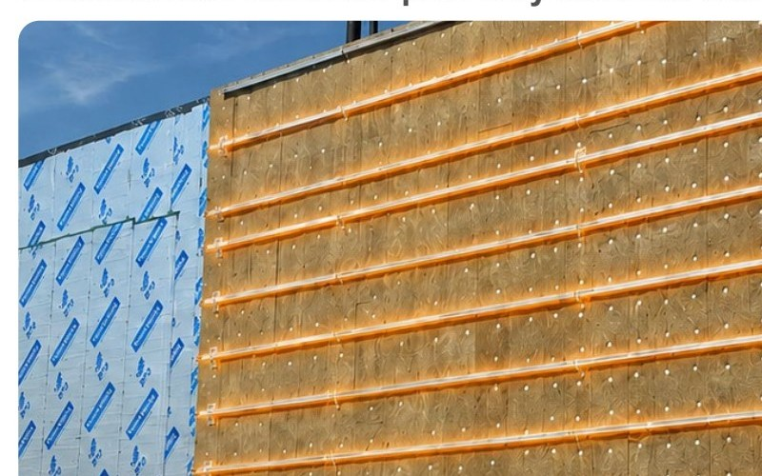
Linear transmittance, Ψ
A continuous heat-flow path may look like a detail. Across its length, it changes the true wall performance.
Ψ
1. WHAT IT IS
Units: W/(m·K)
Added heat flow caused by a continuous line-based thermal bridge, relative to the clear-field wall baseline.
I
2. WHY IT MATTERS
Rails, slab edges, girts, and continuous metal paths can create repeated heat-flow penalties across the wall.
↗
3. HOW IT SCALES
Ψ × total length (L) ÷ gross wall area (A) = assembly correction
Longer continuous paths, same wall area = larger thermal penalty.
Continuous bridge impacts become whole-wall consequences.
Higher linear transmittance can increase effective U-value, energy demand, and condensation risk.
Linear transmittance is not just a rail property. It is the length-based penalty that converts continuous details into installed wall performance.
HILTI
Mastering Subframing in Rainscreen Façades - Balancing Performance, Sustainability, and Durability
/ 19

Slide 20
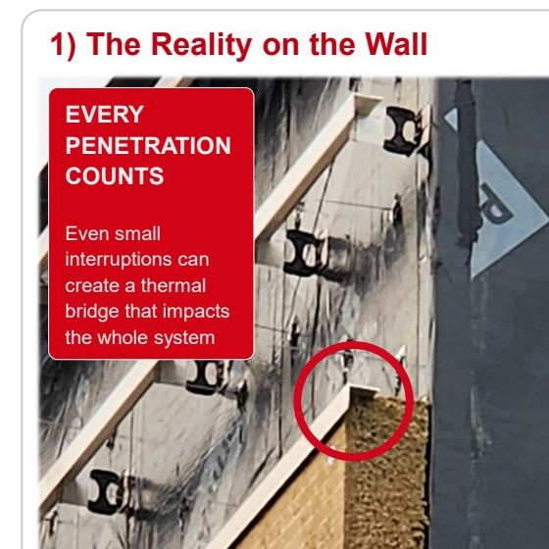
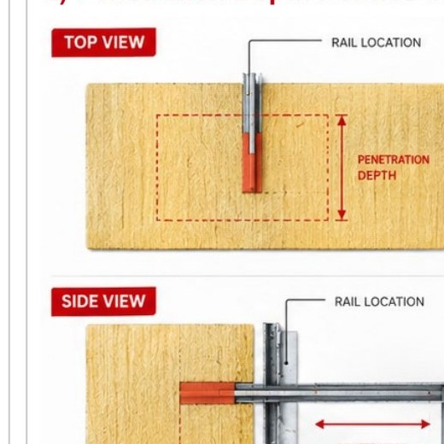
Rail penetration: where the profiles interrupt insulation
The profile creates a conductive path. Its penetration defines how far the insulation layer is interrupted.
1) The Reality on the Wall
2) Penetration Depth Defines Impact
3) Why It Matters
DEFINES INSULATION INTERRUPTION
EVERY
PENETRATION
COUNTS
Determines how much of the insulation layer is interrupted.
Even small interruptions can create a thermal bridge that impacts the whole system
INFLUENCES THERMAL PERFORMANCE
Affects the thermal bridge input used in performance calculations.
REPETITION INCREASES IMPACT
Small penetrations can multiply into a larger whole-wall penalty when repeated.
DRIVES BETTER DECISIONS
Understanding penetration depth helps optimize details and improve assembly performance.
LOCAL PENETRATION
INTERRUPTED INSULATION
ADDED HEAT-FLOW PATH
WHOLE-WALL IMPACT
DESIGN SMARTER.
BUILD BETTER.
→
→
→
Profile penetrates the insulation layer.
Creates a conductive thermal path.
Increases heat transfer through the assembly.
Reduces overall façade thermal performance.
Understand the detail.
Improve the outcome.
HILTI
Mastering Subframing in Rainscreen Façades - Balancing Performance, Sustainability, and Durability
/ 20

Slide 21

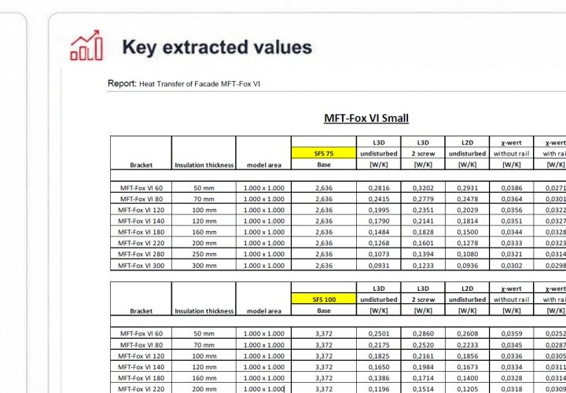
The Values Architects Should Ask For: χ and Ψ
MFT-Fox VI Small, SFS 75 / SFS 100, insulation thickness from 50 mm to 300 mm
Point bridges scale by count. Linear bridges scale by length. This report gives both.
Report Evidence
Key extracted values
Why this matters
• χ quantifies discrete bracket heat flow
• Ψ captures rail / line-based heat flow
Independent Burian & Kram Gutachten
Modeled bracket, rail, screw, and base condition
• Both are required to calculate real Ueff
Multiple insulation thicknesses
Usable χ and Ψ values for Ueff calculations
Credible data turns thermal claims into reviewable inputs.
The thermal report is not backup documentation. It is the source of truth for χ and Ψ used to calculate U_{eff}.
Source: Burian & Kram Bauphysik GmbH, GUTACHTEN V1.0, MFT-Fox VI Small, summarized from report.
HILTI
Mastering Subframing in Rainscreen Façades - Balancing Performance, Sustainability, and Durability
/ 21

Slide 22
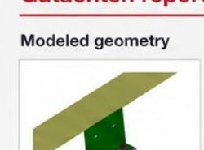
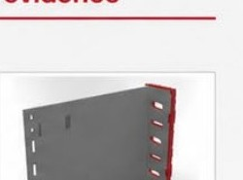
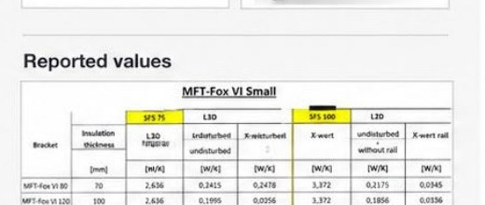
How to review a thermal transmittance report
Gutachten report evidence
Before using χ and Ψ, confirm the modeled inputs match the project.
The report gives χ and Ψ. The project layout gives n and L.
Modeled geometry
1. Match the system
2. Match the wall
• Bracket family and size
• Base material / backup type
• Rail/profile geometry
• Insulation type and thickness
• Stand-off / protrusion
• Layer build-up and cavity
• Thermal break location
• Fastener path
Reported values
3. Verify the report
4. Use the values correctly
• Method / standard used
• χ applies to brackets
• With rail vs without rail
• Ψ applies to rails
• χ = point bridge [W/K]
• Use project n and L later
• Ψ = linear bridge [W/m·K]
• Avoid double counting
■ Independent third-party report
■ System-specific geometry and assembly inputs
■ χ and Ψ values for project calculations
Important: spacing and density do not define χ or Ψ. They matter later in the project Ueff calculation.
U_{eff} = U₀ + (χ × n) / A + (Ψ × L) / A
Recalculate if geometry, backup type, insulation thickness, rail condition, or fastener assumptions change.
HILTI
Mastering Subframing in Rainscreen Façades - Balancing Performance, Sustainability, and Durability
/ 22

Slide 23
Poll Question 2:
On your projects, how often do you request or receive a project-specific thermal report for rainscreen subframing?
A
Almost always, it is part of our normal review process
B
Often, but mainly on higher-performance or more complex projects
C
Sometimes, usually when the owner, energy consultant, or envelope consultant asks for it
D
Rarely or never, we typically rely on insulation R-value or generic product data
E
Other (tell us in the chat!)
HILTI
Mastering Subframing in Rainscreen Façades - Balancing Performance, Sustainability, and Durability
/ 23

Slide 24
Agenda
1.0
Introduction & Objectives
2.0
The Real Impact of Thermal Bridging
3.0
Calculation Workflow
4.0
Design Levers & Best Practices
5.0
From Intent to Reality
6.0
Key Takeaways & Next Steps
HILTI
Mastering Subframing in Rainscreen Façades - Balancing Performance, Sustainability, and Durability
/ 24

Slide 25
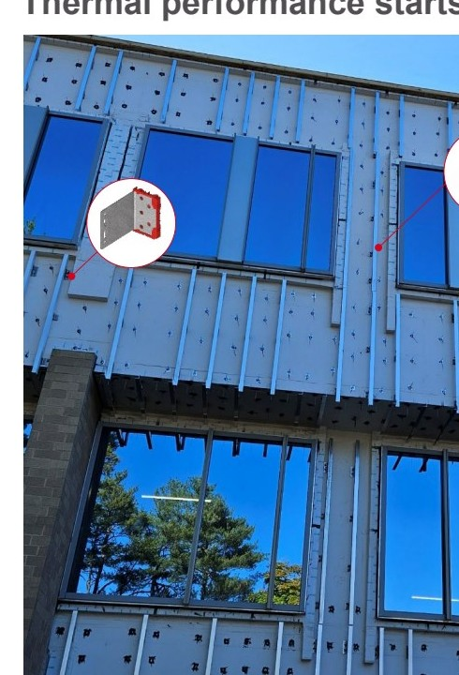
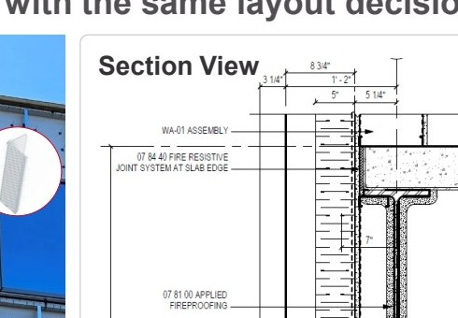
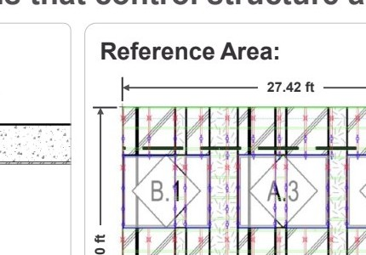
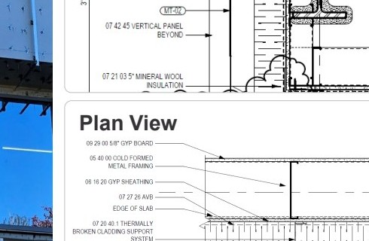
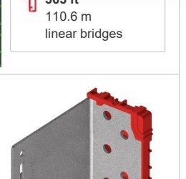
Step 1: Define the thermal inputs
Thermal performance starts with the same layout decisions that control structure and constructability.
Section View
Reference Area:
Reference Area
690.62 ft²
64.17 m²
No. of Brackets
208
point bridges
Total profile length
363 ft
110.6 m
linear bridges
Plan View
Legend
MFT-L 2 1/2"×2"×0.1" 10'-0"
MFT-Z 40×29.8×1.9 6 m
MFT-FOX VTR 100 M
MFT-FOX VTR 100 M
Stainless Steel
Thermally broken bracket
Thermal performance starts with understanding the inputs that influence performance
HILTI
Mastering Subframing in Rainscreen Façades - Balancing Performance, Sustainability, and Durability
/ 25

Slide 26
Step 2: Establish clear-field baseline
Calculate the one-dimensional wall performance before applying thermal bridge corrections
Step 2.1
Step 2.2
Calculate total thermal resistance in metric units
Convert the clear-field baseline to imperial units
Layer (inside to outside)
Thickness [in]
λ [W/m·K]
R contribution [m²·K/W]
Temp. drop [K]
1 m²·K/W = 5.678263 h·ft²·°F/BTU
Interior film (heat transmission inside)
—
—
0.1300
0.4
DensGlass sheathing
0.625
0.128
0.1238
0.5
R0 = 4.361 × 5.678263 = 24.763
rounded to 24.7 h·ft²·°F/BTU
Metal stud frame
6
0.679
0.2246
1.0
U0,metric = 1 / 4.361 = 0.2293 W/m²·K
DensGlass sheathing
0.625
0.128
0.1238
0.5
Mineral wool insulation
5
0.035
3.6286
15.2
U0,imperial = 0.2293 / 5.678263 =
0.0404 BTU/h·ft²·°F
Exterior film (heat transmission outside)
—
—
0.1300
0.6
R0,imperial = 1 / 0.0404 =
24.8 h·ft²·°F/BTU
Rtotal = 4.361 m²·K/W
ΣΔT = 18.5779 K
Contribution to Rtotal
3% 3% 5% 3% 83% 3%
Mineral wool insulation provides about 83% of the total thermal resistance.
This is the thermal starting point.
The clear-field baseline describes the wall before thermal bridges are added.
HILTI
Mastering Subframing in Rainscreen Façades - Balancing Performance, Sustainability, and Durability
/ 26

Slide 27
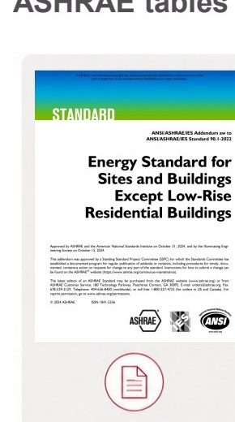
Establishing U₀ via ASHRAE Table A3.3.3.1
ASHRAE tables may apply conservative generic assumptions for broader code applicability.
Table A3.3.3.1 Assembly U-Factors for Steel-Frame Walls by Stud Spacing and Framing Factor
Steel Framing at 16 in. on Center (22% Framing Factor) · Overall U-Factor for Base Wall Plus Continuous Insulation
Cavity
1
2
3
4
5
6
7
8
9
10
11
12
13
14
15
20
25
30
35
40
R-11
0.166
0.142
0.124
0.111
0.100
0.091
0.083
0.077
0.071
0.066
0.062
0.059
0.055
0.053
0.050
0.040
0.033
0.029
0.025
0.022
R-13
0.158
0.137
0.120
0.107
0.097
0.088
0.081
0.075
0.070
0.065
0.061
0.058
0.055
0.052
0.049
0.040
0.033
0.028
0.025
0.022
R-15
0.153
0.133
0.117
0.105
0.095
0.087
0.080
0.074
0.069
0.064
0.060
0.057
0.054
0.051
0.049
0.039
0.033
0.028
0.025
0.022
R-19
0.145
0.127
0.112
0.101
0.092
0.084
0.077
0.072
0.067
0.063
0.059
0.056
0.053
0.050
0.048
0.039
0.032
0.028
0.024
0.022
R-21
0.142
0.124
0.110
0.099
0.090
0.083
0.077
0.071
0.066
0.062
0.059
0.055
0.052
0.050
0.048
0.038
0.032
0.028
0.024
0.022
R-25
0.137
0.121
0.108
0.097
0.089
0.081
0.075
0.070
0.065
0.061
0.058
0.055
0.052
0.049
0.047
0.038
0.032
0.028
0.024
0.022
R-30
0.133
0.117
0.105
0.095
0.087
0.080
0.074
0.069
0.064
0.060
0.057
0.054
0.051
0.049
0.046
0.038
0.032
0.027
0.024
0.021
Selected lookup: U0 = 0.045
Published table values for broad code applicability
Results via ASHRAE Table A3.3.3.1
Results via EN ISO 6946
U0 = 0.045
U0 = 0.040
Steady-state 1-D calculation with detailed layer inputs
ASHRAE tables use generic framing assumptions
Detailed calculations use project-specific material properties
Both are useful, but they serve different purposes
Key takeaway: Use the table for quick code-aligned benchmarking, but use project-specific calculations when accuracy matters.
HILTI
Mastering Subframing in Rainscreen Façades - Balancing Performance, Sustainability, and Durability
/ 27

Slide 28
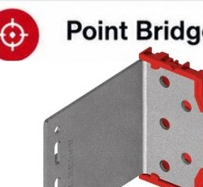
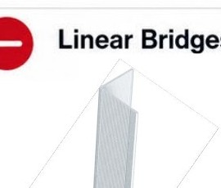
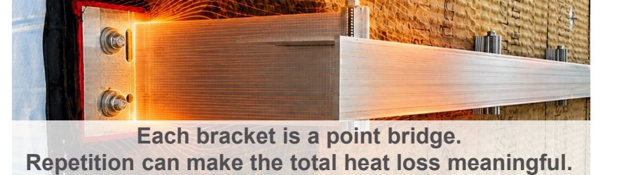
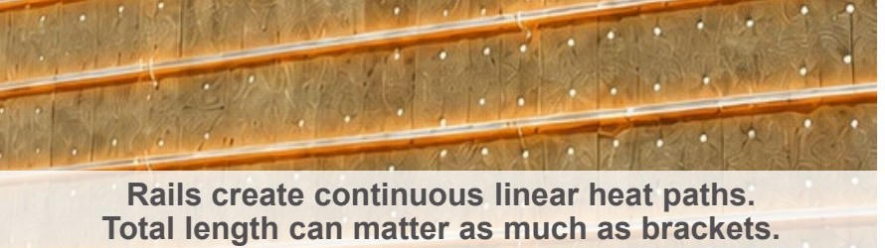
Step 3: Quantify thermal bridges in the reference area
Identify every repeated point bridge and every continuous linear bridge before correcting the assembly
Point Bridges: Brackets
—
Linear Bridges: Rails
208 total brackets
363 ft total rail length
Component: MFT-FOX VTR 100 M
110.64 m total rail length
Component: MFT-L rail, 2½ in × 2 in × 0.10 in
Point thermal transmittance:
χ = 0.00200 W/K each
Linear thermal transmittance:
Ψ = 0.0068 W/m·K
Total point loss =
208 × 0.00200 = 0.416 W/K
Total linear loss =
110.64 × 0.0068 = 0.752 W/K
Normalized contribution:
Σ χ · n / A =
0.00648 W/m²·K
Normalized contribution:
Σ Ψ · L / A =
0.011727 W/m²·K
0.00648 × 0.17611 = 0.00114 BTU/h·ft²·°F
0.011727 × 0.17611 = 0.00206 BTU/h·ft²·°F
HILTI
Mastering Subframing in Rainscreen Façades - Balancing Performance, Sustainability, and Durability
/ 28

Slide 29
Step 4: Convert the baseline into effective performance
Add thermal bridge corrections to the clear-field baseline to establish the true wall performance
1
2
3
Clear-Field Baseline
Add Thermal Bridge Corrections
Effective Assembly Performance
Ueff = U0 + point bridges + linear bridges
→
→
R_{eff} = 22.9
R₀ = 24.7
Point bridges
Linear bridges
h·ft²·°F/BTU
0.00114
0.00206
h·ft²·°F/BTU
BTU/h·ft²·°F
BTU/h·ft²·°F
Ueff = 0.0436 BTU/h·ft²·°F
Equivalent U0 = 0.0404 BTU/h·ft²·°F
Total correction = 0.0032 BTU/h·ft²·°F
R-1.8
lower than
clear-field
7.1%
lower R-value
due to bridges
Ideal wall, before
thermal-bridge corrections
36%
64%
36% of correction 64% of correction
The wall performs at R-22.9, not R-24.7. Thermal bridges from brackets and rails reduce effective R-value by 1.8 R (7.1%). Design with the corrected value, not the clear-field number.
HILTI
Mastering Subframing in Rainscreen Façades - Balancing Performance, Sustainability, and Durability
/ 29

Slide 30
Thermal bridge impact comparison
Aluminum at 16 in. horizontal spacing vs. Stainless steel at 32 in. O.C.
Stainless steel @ 32 in. O.C.
Aluminum @ 16 in. spacing
Lower thermal penalty
Higher thermal penalty
Brackets
208
Brackets
416
Total rail length
363 ft
Total rail length
726 ft
Point bridges
0.416 W/K
Point bridges
3.120 W/K
Linear bridges
0.752 W/K
Linear bridges
1.505 W/K
Total extra heat loss
1.168 W/K
Total extra heat loss
4.625 W/K
Corrected U-value
0.043 BTU/h·ft²·°F
Corrected U-value
0.053 BTU/h·ft²·°F
Effective R-value
R-23.3
Effective R-value
R-18.9
Nearly 3×
+23%
-4.4 R
total extra heat loss
higher U-value
lower effective R-value
1. Point bridges increase sharply with bracket count and material conductivity.
2. Linear bridge impact also rises because tighter spacing requires more rail length.
3. Compare systems using delivered whole-wall performance, not hardware or insulation alone.
Design implication: the support strategy can shift whole-wall performance from R-23.3 to R-18.9.
HILTI
Mastering Subframing in Rainscreen Façades - Balancing Performance, Sustainability, and Durability
/ 30

Slide 31
Thermal performance is driven by the support strategy
Same insulation, different support decisions can materially change the effective R-value.
1. Reference vs delivered result
2. Ranked drivers of the penalty
3. How the wall steps down
Rank Driver Impact Share
Total change
-4.40 R about 18.9% lower
1
Bracket conductivity
-3.16 R
71.8%
Stainless → Aluminum
Reference clear-field wall
R0 23.3
R₀ = 23.3
2
Bracket count / density
-0.83 R
18.9%
208 → 416
-3.16 R
h·ft²·°F/BTU
3
Rail length / linear
-0.37 R
8.4%
-0.83 R
Effective installed wall
363 ft → 726 ft
R_{eff} = 18.9
-0.37 R
4
Combined effects
-0.04 R
0.9%
h·ft²·°F/BTU
Interaction of changes
Reff 18.9
Total penalty = -4.40 R
about 18.9% lower effective R-value
Total penalty = -4.40 R Largest driver: bracket conductivity
Start conductivity count rails Final
4. Design relevance
Material selection
Support density / spacing
Rail continuity / length
Model the actual layout
Lower-conductivity supports reduce the largest source of penalty.
More brackets increase repeated point bridges.
Longer and more continuous rails increase linear bridging.
Judge systems by effective whole-wall performance, not nominal insulation alone.
Thermal performance is a system outcome. The key model levers, conductivity, quantity, and continuity, are all design decisions.
HILTI
Mastering Subframing in Rainscreen Façades - Balancing Performance, Sustainability, and Durability
/ 31

Slide 32
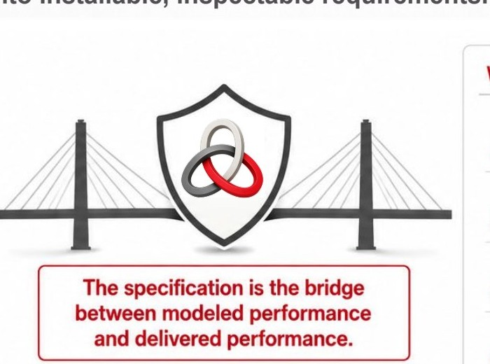
The specifications protect the thermal model
Convert modeled assumptions into installable, inspectable requirements.
What the model accounts for
What the model does not account for
Support material and conductivity
Gaps and voids
Bracket spacing / density
Shims and conductive bypasses
Rail continuity and length
Insulation compression or damage
Installation tolerances and continuity breaks
Defined thermal bridge assumptions
The specification is the bridge between modeled performance and delivered performance.
The model is only valid for the assumptions it analyzes.
These field conditions can reduce delivered thermal performance.
It locks in the variables the model assumes and controls the field conditions the model cannot see.
High-performing
Code-compliant
Buildable
Well-engineered
Cost-optimized
HILTI
Mastering Subframing in Rainscreen Façades - Balancing Performance, Sustainability, and Durability
/ 32

Slide 33
Poll Question 3:
When bracket spacing, rail layout, fasteners, shims, or support geometry change during delegated design or submittal review, how is thermal impact typically handled on your projects?
A
The change is usually reviewed for structural performance only
B
The team checks that insulation thickness remains the same
C
The team requests a thermal re-check or updated effective U-value/R-value
D
It depends on the project team, consultant, specification, or timing
HILTI
Mastering Subframing in Rainscreen Façades - Balancing Performance, Sustainability, and Durability
/ 33

Slide 34
Agenda
1.0
Introduction & Objectives
2.0
The Real Impact of Thermal Bridging
3.0
Calculation Workflow
4.0
Design Levers & Best Practices
5.0
From Intent to Reality
6.0
Key Takeaways & Next Steps
HILTI
Mastering Subframing in Rainscreen Façades - Balancing Performance, Sustainability, and Durability
/ 34

Slide 35
Delegated design can compromise design intent
Thermal intent is rarely lost in one decision. It drifts through substitution, coordination and installation. The risk is cumulative drift.
1
2
3
4
Substitutions are thermal changes
Final geometry must match the model
Hidden penalties live in the details
Field fixes can rewrite performance
• Structural equal does not mean thermal equal.
• Bracket, clip, fastener, or pad swaps can change thermal-bridge effects.
• Spacing, stand-off, rail orientation, and density are thermal variables.
• More metal or longer projection raises bridge impact.
• Fasteners, shims, washers, splice plates, and clips are repeated bridges.
• If secondary metal is ignored, performance is overstated.
• Shim stacks, notches, compression, and work-arounds alter heat flow.
• Installed conditions can quietly diverge from the drawing.
›
›
›
Question to ask
Question to ask
Question to ask
Question to ask
What thermal variable changed?
Did the final layout still match the model?
What was left out of the thermal path?
What is allowed before a thermal recheck is required?
A wall can also be thermally improved on paper and still fail if it is not structurally sound or buildable. Balanced performance requires every substitution to be checked against the same thermal, structural, and constructability basis.
HILTI
Mastering Subframing in Rainscreen Façades - Balancing Performance, Sustainability, and Durability
/ 35

Slide 36
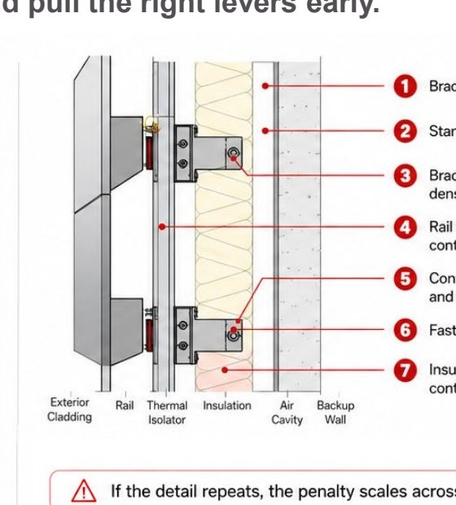
Design control starts with clear boundaries
Define the thermal basis and pull the right levers early.
1
Set the Thermal Basis
2
Pull the Design Levers
Define the reference area and boundary conditions
Bracket density: fewer supports, less bridging
Material choice: stainless reduces conductivity
Separate clear-wall U from installed-wall U
Orientation: rail direction changes heat flow path
Account for point bridges (χ) and linear bridges (Ψ)
Contact area: minimize bearing and shims
Include slab edges, corners, parapets, and joints
Thermal isolator: reduce the direct metal path
Insulation coordination: protect continuity at every support
Check interior surface temperature risk (fRsi), not U-value alone
Detail zoning: expect a higher penalty at edges and transitions
If the detail repeats, the penalty scales across the façade.
What good specifications and submittals must require
✓ Installed-wall thermal calculation with stated assumptions ✓ Support schedule: spacing, stand-off, bracket type, isolator ✓ Critical details: slab edge, opening, corner, movement joint ✓ Surface temperature / condensation check at key conditions
HILTI
Mastering Subframing in Rainscreen Façades - Balancing Performance, Sustainability, and Durability
/ 36

Slide 37
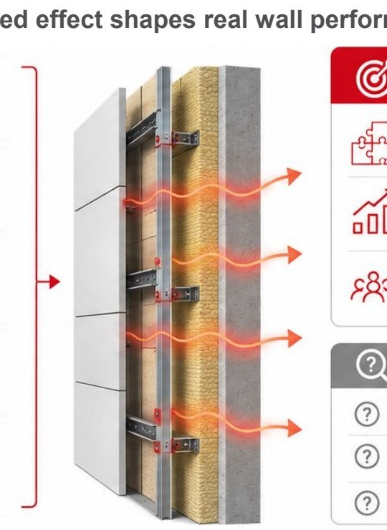
What moves the results the most
Five design variables work together. Their combined effect shapes real wall performance and owner value.
1
Material
Up to 3x difference in heat transfer.
What leadership should remember
Conductivity of brackets, rails, and fasteners.
Thermal performance is a system outcome, not a single-product property.
Small support decisions can compound into major energy and comfort impacts.
The best results come from optimizing the full pattern, not one isolated variable.
2
Geometry
Up to 40% variation in conductive path.
Shape, thickness, cross-section, and contact area.
3
Spacing
+25–60% heat-loss increase with frequent support repetition.
Support density, spacing, and repetition frequency.
4
Continuity
Continuous paths can drive 2–5x more loss than discrete supports.
Continuous lines vs. discrete point-based support conditions.
Questions to ask
5
Interruption Strategy
Up to 80% reduction in heat transfer with effective thermal interruption.
? What materials are carrying heat?
? How much metal crosses the insulation layer?
? Is there a true thermal-break strategy?
Thermal breaks, isolators, and strategies that reduce conductive continuity.
Thermal performance is protected when material, geometry, spacing, continuity, and insulation interruption are designed as one coordinated system.
HILTI
Mastering Subframing in Rainscreen Façades - Balancing Performance, Sustainability, and Durability
/ 37

Slide 38
Thermal performance starts in the specifications
Specify the right targets. Define the details. Deliver the performance.
1. Whole-wall thermal target
2. Subframing + bracket criteria
3. Insulation coordination
Most Common Thermal Spec Gaps
• Effective assembly U-value / R-value
• Thermal bridge allowance (Ψ / χ impact)
• Interior surface temperature / condensation criterion
• Allowed bracket materials, geometry, conductivity limits
• Maximum bracket density / spacing assumptions
• Thermal isolator requirements at support interfaces
• Insulation type, thickness, lambda, density
• Continuity, compression, and gap control at penetrations
• Air-permeability / wind-washing protection around supports
×
Nominal insulation specified, effective assembly not enforced
×
Structural bracket selection ignores thermal penalty
×
“Continuous insulation” not defined at penetrations and junctions
4. Cavity + dynamic effects
5. Junction continuity
6. Modeling, delegated design + verification
• Ventilated cavity depth and configuration
• Vent sizing / compartmentalization strategy
• Control of convective looping and solar-driven airflow effects
• Window, slab edge, parapet, corner, and base transitions
• Coordination between subframing, AWB, insulation, and adjacent systems
• No thermal short-circuiting at interfaces
• Project-specific 3D thermal modeling (ISO 10211 or equivalent)
• Re-model trigger for substitutions or spacing changes
• Defined roles, submittals, mock-up / field verification checkpoints
×
No project-specific thermal modeling
×
No re-check after substitutions or value engineering
If the specification is silent, thermal intent is optional. If it is clear and verifiable, performance becomes enforceable.
HILTI
Mastering Subframing in Rainscreen Façades - Balancing Performance, Sustainability, and Durability
/ 38

Slide 39
Agenda
1.0
Introduction & Objectives
2.0
The Real Impact of Thermal Bridging
3.0
Calculation Workflow
4.0
Design Levers & Best Practices
5.0
From Intent to Reality
6.0
Key Takeaways & Next Steps
HILTI
Mastering Subframing in Rainscreen Façades - Balancing Performance, Sustainability, and Durability
/ 39

Slide 40
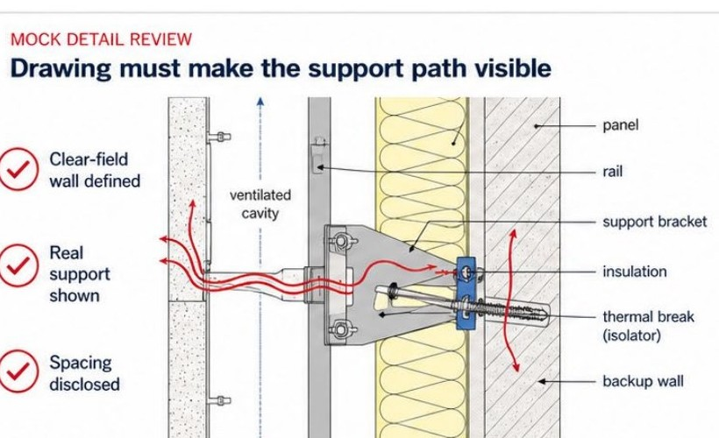
What good looks like
Make the support path visible. Then the thermal logic becomes reviewable.
MOCK DETAIL REVIEW
MOCK REPORT SUMMARY
Drawing must make the support path visible
Report must make the thermal basis reviewable
Clear-field wall defined
Corrected assembly result
Real support shown
Reff = 15.2 Ueff = 0.066
Spacing disclosed
Clear-field wall
Base assembly defined before support correction
Support condition
Bracket and rail condition modeled as shown
Spacing / density
24 in. vertical, 48 in. horizontal
Thermal correction
Linear and point penalties included
Local temperature check
Condensation-sensitive locations reviewed
Assumptions
Boundary conditions and material assumptions visible
Detail review: the bridge path must be legible, not implied.
Thermal transparency turns drawings and reports into reviewable decisions.
1. Is the support path visible?
2. Is the corrected assembly value shown?
3. Are risks and assumptions disclosed?
HILTI
Mastering Subframing in Rainscreen Façades - Balancing Performance, Sustainability, and Durability
/ 40

Slide 41
Thermal variables that get overlooked
THERMAL REPORT SUMMARY
1. Nominal-only value
Nominal R-value:
R-25
2. Generic support description
Clear-field U-factor (U0):
0.24
Surface condensation:
Pass
3. No spacing shown
Average wall performance can hide local thermal danger
Model:
XYZ Building Rev. A
4. No local temperature discussion
WALL ASSEMBLY (TYP)
1 Exterior cladding · 2 Continuous insulation · 3 Air / water barrier · 4 Backup wall · 5 Support bracket · 6 Interior finish
5. No bridge correction logic
THERMAL PERFORMANCE SUMMARY
Is there spacing?
How is bridging reduced?
Baseline U-factor: 0.48
Proposed U-factor: 0.24
Improvement: 50%
Is it safe at design lows?
Are substrate temps shown?
Whole-wall averages do not always reveal local risk.
HILTI
Mastering Subframing in Rainscreen Façades - Balancing Performance, Sustainability, and Durability
/ 41

Slide 42
Thermal intent must survive the traditional project path
Modeling creates the target, but performance survives only when the logic is translated into details, specifications, and field verification.
1
2
3
4
MODEL
DETAIL
SPECIFY
VERIFY
Build an honest heat-flow baseline
Translate assumptions into buildable geometry
Write the critical thermal assumptions into the project requirements
Confirm the installed wall still matches the intent
• Start with clear-field performance
• Include support effects, ψ and χ corrections
• Make the assumptions visible
→
• Show spacing, support type, continuity, and thermal breaks
• Expose the real thermal path
• Make the design reviewable
→
• Protect the intended support strategy
• Define acceptable substitutions
• Carry thermal intent into procurement
→
• Check field conditions and installation quality
• Validate key thermal features
• Close the gap between design and reality
If missed: the baseline is wrong
If missed: the thermal logic disappears in the drawings
If missed: performance is value-engineered away
If missed: installed reality drifts from intent
Thermal performance depends on continuity from analysis to installation. The modeled assumptions must remain visible in the details, enforceable in the specification, and verifiable in the installed wall.
1. A model defines the target 2. Assumptions must become project requirements 3. Verification confirms delivered performance
HILTI
Mastering Subframing in Rainscreen Façades - Balancing Performance, Sustainability, and Durability
/ 42

Slide 43
Best practices that help protect thermal intent
Immediate actions that help improve thermal decisions
1
Evaluate the wall as an assembly
What changes in practice?
Do not equate nominal R-value with real wall performance.
2
Ask for real support geometry and spacing
Sharper reviews
Thermal claims depend on the actual support condition and spacing logic.
Better questions at submittal stage.
3
Check the bridge-correction logic
Clear-field values alone do not explain assembly performance.
Better questions at submittal stage
Fewer disconnects across teams.
4
Coordinate spacing, support strategy, and insulation early
Early coordination decisions shape the final thermal outcome.
More defensible decisions
Carry thermal intent into details, specifications, and field verification
Thermal intent is easier to protect.
5
Performance only survives when the logic is translated and verified through delivery.
Thermal intent survives only when the project team treats performance as a coordinated system, not a nominal number.
Good thermal decisions connect analysis, detailing, specification, and field execution.
HILTI
Mastering Subframing in Rainscreen Façades - Balancing Performance, Sustainability, and Durability
/ 43

Slide 44
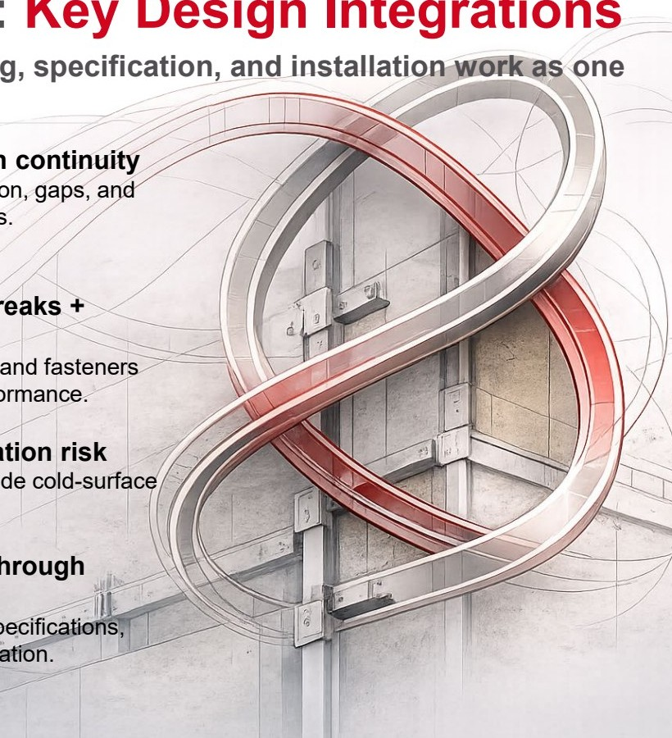
Optimizing Thermal Performance: Key Design Integrations
Thermal performance is protected when modeling, detailing, specification, and installation work as one coordinated system.
1. Design the wall as an assembly.
5. Protect CI + insulation continuity
Compare effective wall performance, not nominal insulation alone.
Avoid notching, compression, gaps, and uncoordinated penetrations.
2. Ask for U0, Ueff, χ, and Ψ
6. Coordinate thermal breaks + fasteners
Make the clear-field baseline and thermal-bridge corrections visible.
Isolators, shims, washers, and fasteners can change delivered performance.
3. Control support strategy
7. Check local condensation risk
Material, stand-off, geometry, and contact area all influence heat flow.
Average wall values can hide cold-surface risk at critical details.
4. Limit support density + continuity
8. Carry thermal intent through delivery
Bracket count and rail length can quietly drive whole-wall heat loss.
Translate the model into specifications, submittals, and field verification.
HILTI
Mastering Subframing in Rainscreen Façades - Balancing Performance, Sustainability, and Durability
/ 44

Slide 45
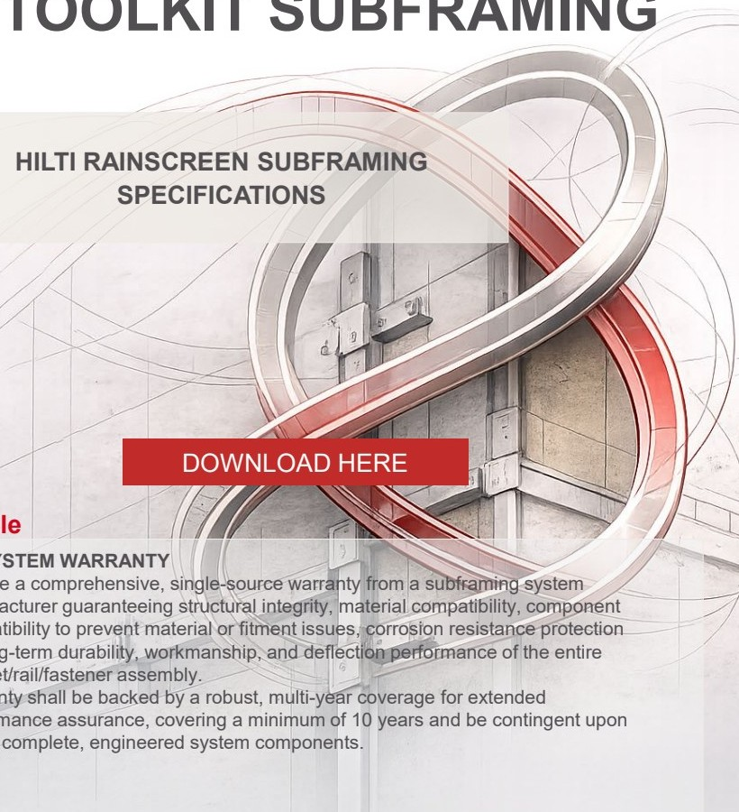
DOWNLOAD SPECIFICATIONS & TOOLKIT SUBFRAMING DESIGN HERE
BEST CONSTRUCTABILITY PRACTICES FOR RAINSCREEN SUBFRAMING SYSTEM DESIGN
HILTI RAINSCREEN SUBFRAMING SPECIFICATIONS
Smooth submittals that include material that show spec compliance
DOWNLOAD HERE
DOWNLOAD HERE
Example
Example
PROJECT PLANNING & SPECIFICATION PHASE
1.6 SYSTEM WARRANTY
• Define project-specific thermal range (ΔT): Calculate as (extreme high temp – extreme low temp) relative to installation temperature, based on city/state data.
• Assign responsibilities early: Clearly state who verifies the global base material (e.g., substrate integrity).
• Specify base material types and properties: Explicitly define type(s), performance criteria, and properties to avoid ambiguities.
• Specify metal stud properties: Include thickness, yield strength, ultimate capacity (not just gauge), and establish clear stud spacing.
• Integrate wind pressure details into structural drawings: Provide pressures for components vs. cladding; state LRFD vs. ASD level; indicate ASCE edition; detail zone wall 4 vs. 5.
Provide a comprehensive, single-source warranty from a subframing system manufacturer guaranteeing structural integrity, material compatibility, component compatibility to prevent material or fitment issues, corrosion resistance protection for long-term durability, workmanship, and deflection performance of the entire bracket/rail/fastener assembly. Warranty shall be backed by a robust, multi-year coverage for extended performance assurance, covering a minimum of 10 years and be contingent upon use of complete, engineered system components.
HILTI
Mastering Subframing in Rainscreen Façades - Balancing Performance, Sustainability, and Durability
/ 45

Slide 46
HILTI
QUESTIONS?
Hilti North America
(877) 879-6337
HNAtechnicalservices@hilti.com
www.us.hilti.com/engineering
Mastering Subframing in Rainscreen Façades - Balancing Performance, Sustainability, and Durability
46

